Slide 1
Challenges in Urban Geology while Developing Jaipur and Ajmer as Smart Cities in Dryland Environment of India
Dr. Sudesh Kumar Wadhawan
Director General [Retd.]
Geological Survey of India
<wadhawansk.leo@gmail.com>

Slide 2
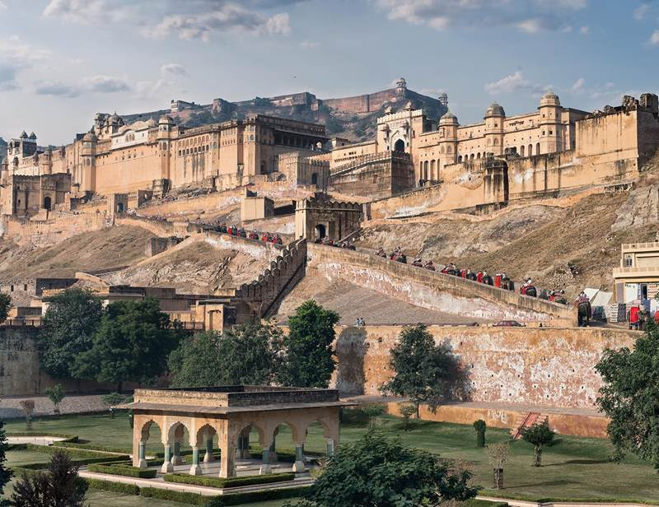
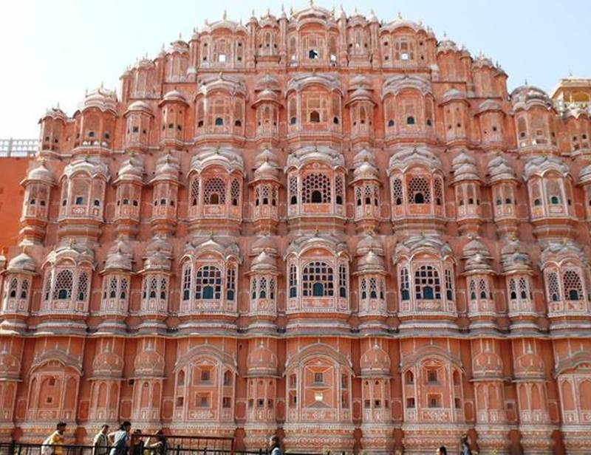

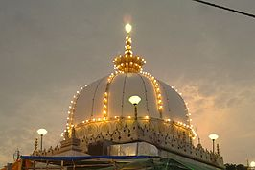
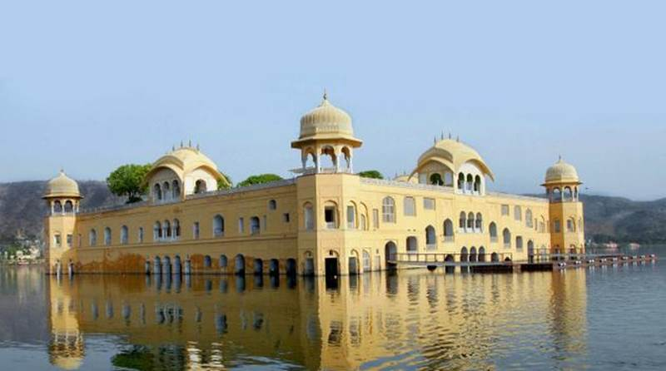
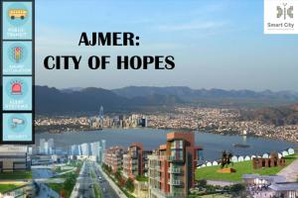
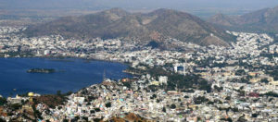
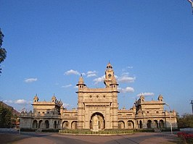
JAIPUR: PINK CITY

Slide 3
SMART AND HERITAGE CITIES –
Challenges in URBAN GEOLOGY
Jaipur Urban Region and Ajmer Metropolitan Smart Cites*
Incorporation of Information and Communication Technology [ICT] into public services
Also rich heritage, cultural, and religious tourist destinations in dryland environment of W India
Need greater focus on tourism related amenities
Located along ecologically fragile eastern margin of the Thar Desert on the west, the region is a transitional zone between the humid east and the arid west
Notes:
*as per the ongoing Smart Cities Mission of Government of India since 25th June 2015

Slide 4
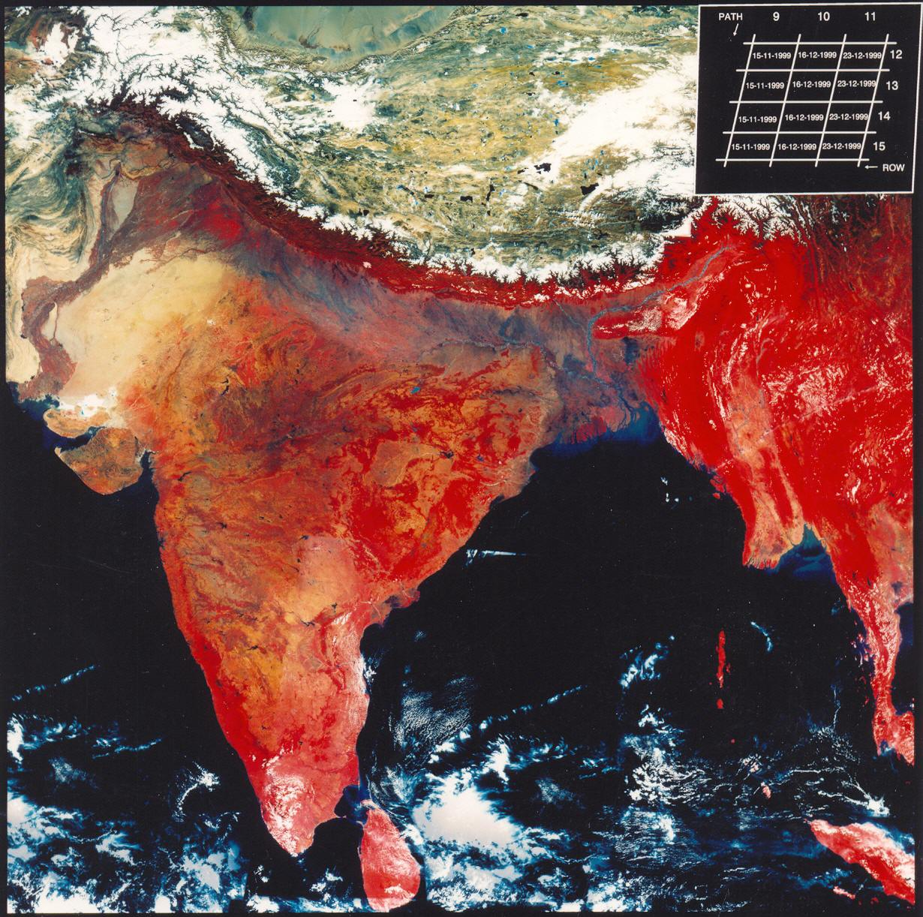
DRYLAND ENVIRONMENT OF JAIPUR – AJMER REGION
Receive less than 25 cm average rainfall
Erratic down-pours → sudden violent thunderstorms → flash-flooding
High evapo-transpiration
Ephemeral fluvial courses
Inland drainage: Lakes & Playas
Salinity in groundwater / lack of flushing
Carbonates and gypsum rich soils
Support mostly xerophytic vegetation

Slide 5
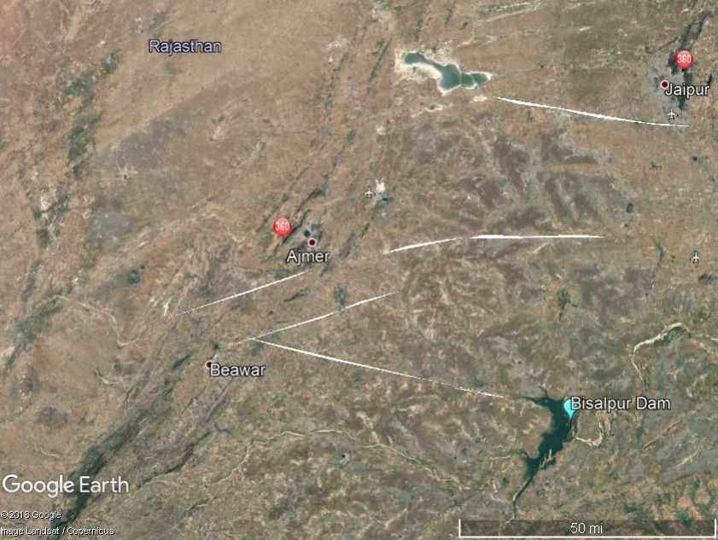

Slide 6
GEOFACTORS and GEOLOGIC CYCLE
Earth is essentially is a closed system and its resources are limited. [However, exchange of Energy and Material in solar system makes it an open system ]
FOUR GREAT EARTH REALMS: Lithosphere; Atmosphere; Hydrosphere; Biosphere
GEOLOGIC CYCLE: Earth Processes Operate in Group of Sub-cycles: Tectonic; Hydrological; Geochemical and Rock Cycles
Significant geofactors influencing evaluation of resources and geohazards are: Tectonic cycle and Hydrological cycle [that move, produce and change earth materials through Geochemical and Rock cycles]
Notes:
ATMOSPHERE IS A GAESOUS LAYER ABOUT 30 km THICK – with upward thinning rarefied density
LIFE LAYER: Upper 100 m in oceans and about 5 km THICK LAYER above Earth’s surface SUPPORTS LIFE

Slide 7
Climatic domain influences the type and intensity of geomorphic processes
Four major challenges:
Comprehensive evaluation and quantification of supply and demand [Resource Prognostication];
Enhanced understanding of the subsurface as it relates to geo-hydrology, soils and foundation grade resource [Geophysical probes, GPRadar surveys]
3. Assessment of where new resources are likely to be found and plan for integrated optimum utilisation
4. Developing the needed and advanced skills capacity, particularly in IT enabled services, affordable health care, quality monitoring, disaster management, etc.
The Resourcing Future Generations initiative will provide a bridge between industry, academia, and national geological surveys.

Slide 8
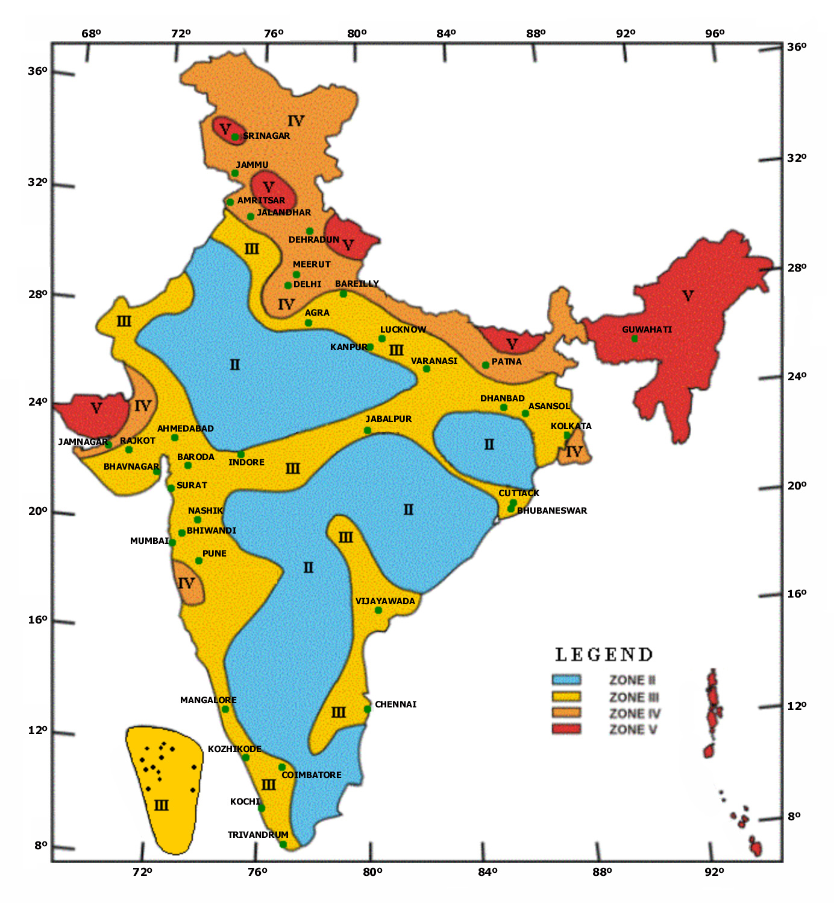
SEISMO-TECTONICS
Zone | Magnitude
Zone V | Very High Risk Quakes of Magnitude 8 and greater
Zone IV | High Risk Quakes upto Magnitude 7.9
Zone III | Moderate Risk Quakes upto Magnitude 6.9
Zone II | Seismic Disturbances upto Magnitude 4.9
Source: IS 1893 (Part 1) : 2002 (BIS)

Slide 9
GEOFACTOR CONSIDERATIONS- ABIOTIC
1. GEOLOGY: [Rock types, Spatial distribution, Structures,
Weathering and nature of alterations
Stratigraphic succession, and
Geotechnical properties – load-bearing, porosity, permeability
2. GEOMORPHOLOGY (Landforms),
Erosion/deposition regimes
Relief and Slopes - character and direction
Drainage courses, channels
Neo-tectonics, active faults
3. WATER RESOURCES –Surface and Groundwater,
Water quality
Effluent/ influent regimes; Discharge, flood plain
Wetlands, water bodies

Slide 10
GEOFACTOR CONSIDERATIONS ..
4. SOILS [PEDOLOGY]
Soil types: sand-silt-clay contents
salinity, alkalinity, NKP, etc.
Land capability and Irrigability Classes
Palaeosols, calcretes, etc.
5. METEOROLOGY: rainfall pattern, winds, extreme events, flash floods, etc.
6. OPERATIVE NATURAL PROCESSES: seismicity, Lineaments, soil erosion, winds: dust storms, drainage basins, mass movement

Slide 11
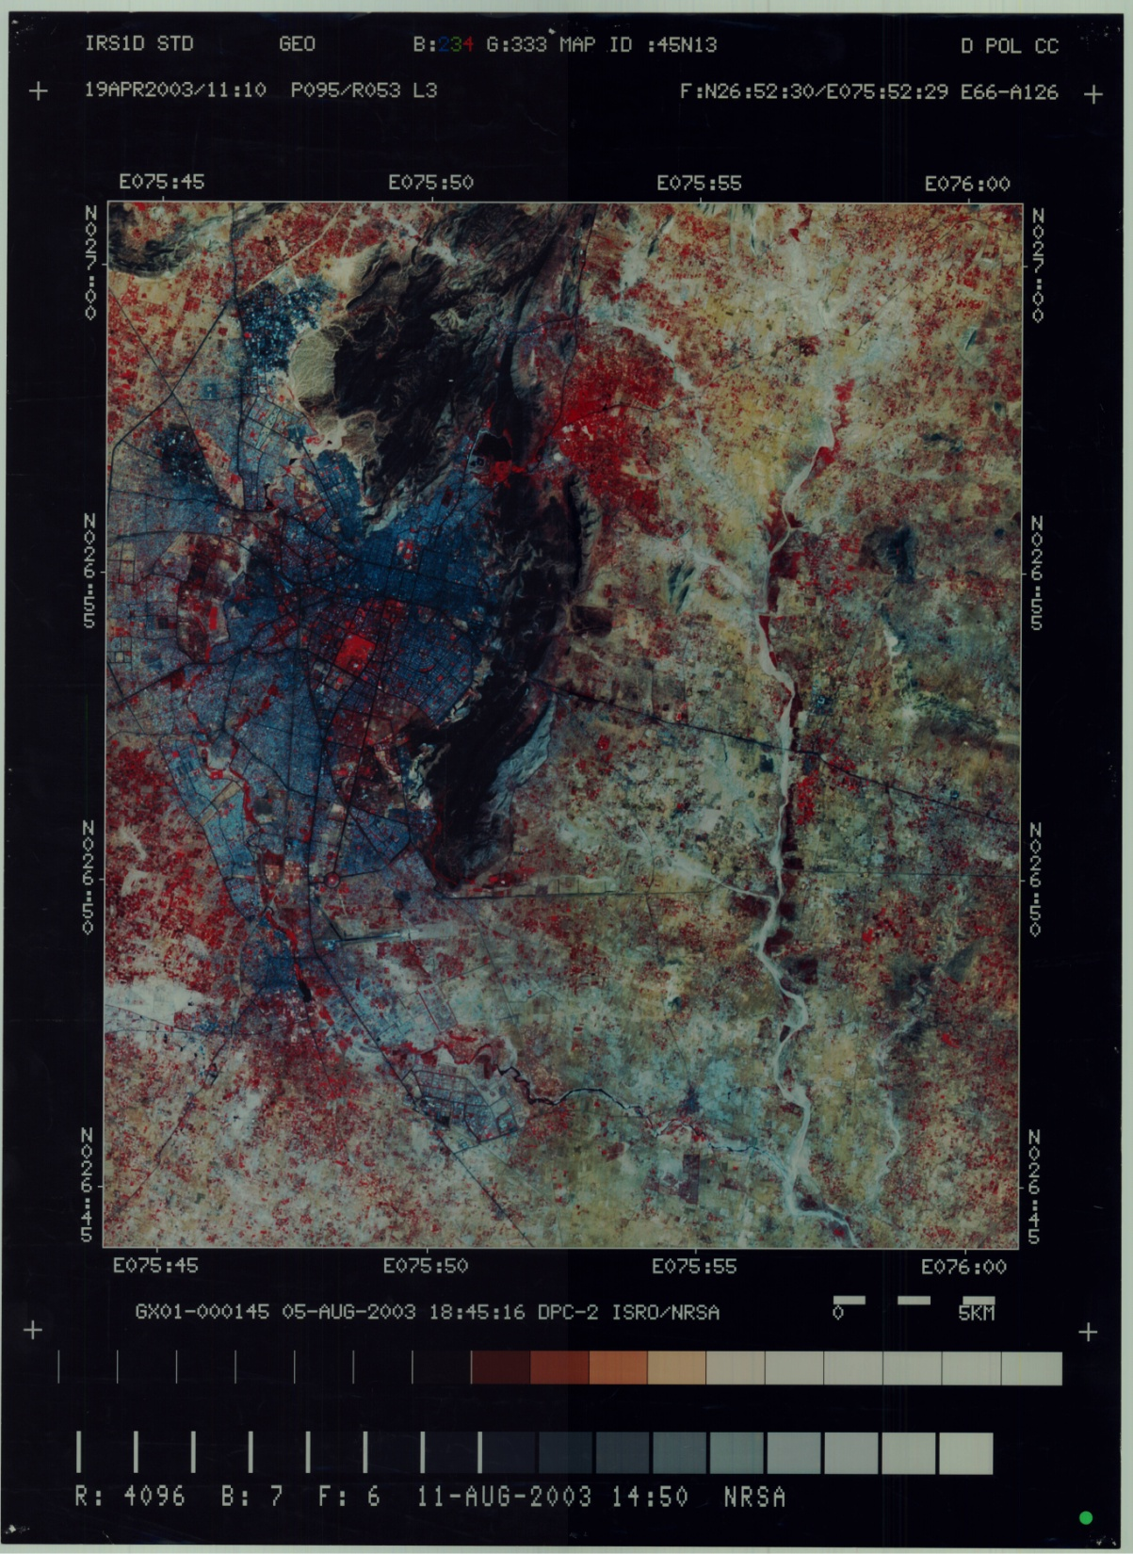
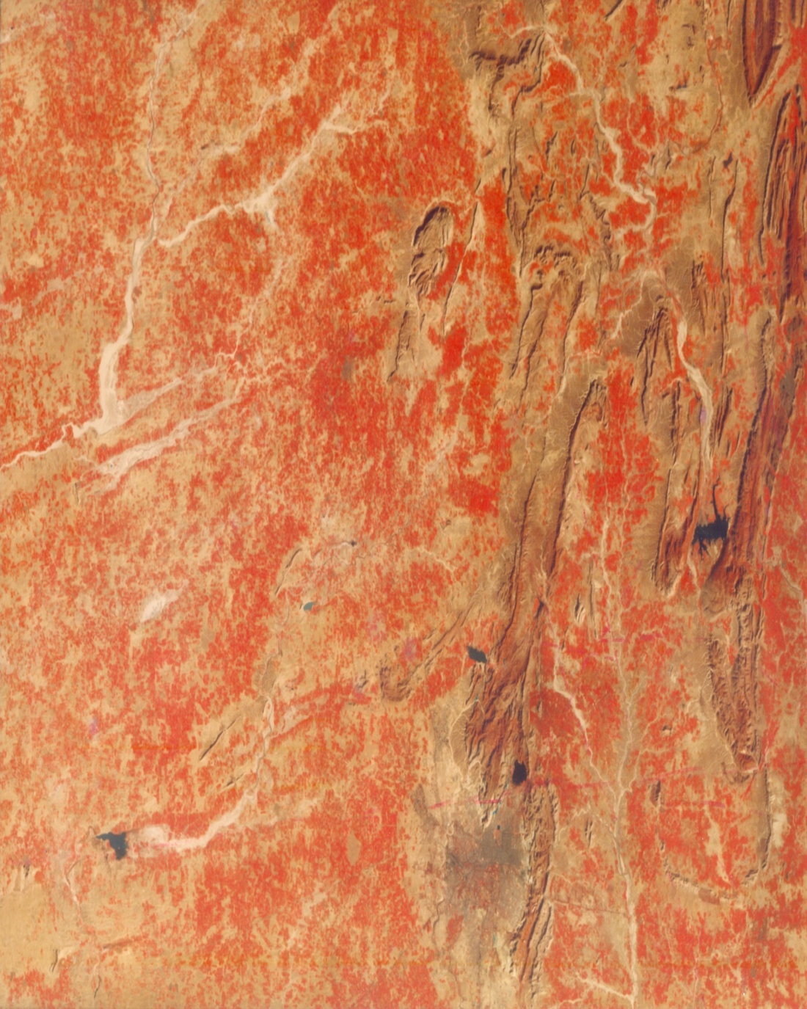
GEOENVIRONMENTALLY SAFE URBAN DEVELOPMENT
JAIPUR

Slide 12
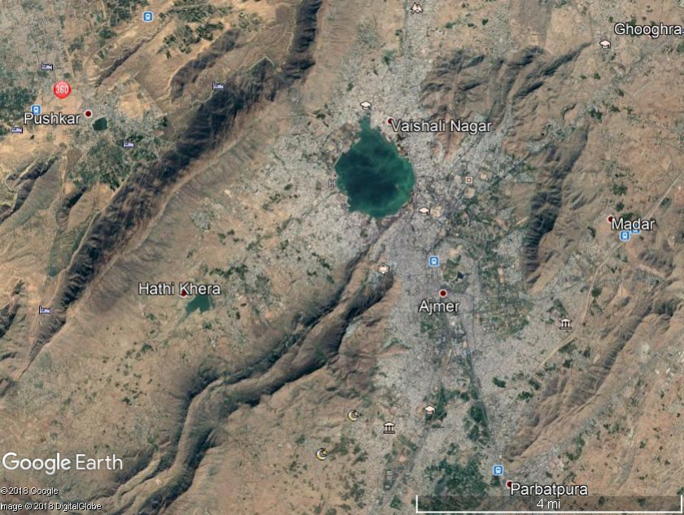
AJMER

Slide 13
URBAN SECTOR PRESSURES
Rapid urbano-industrial growth with RISING MIGRANTS AND POPULATION DENSITY exerting pressures on infrastructure, civic amenities, services, water and power supplies, waste disposal/ management and sewerage treatment facilities
Conversion of agricultural land for non-agricultural uses and overexploitation of groundwater resources
Need to address Planned Housing and Traffic Congestion/ Transportation issues
Unplanned growth, large scale mismatch of landuse/ land capabilities lead to enhanced propensity of environmental geohazards in the region

Slide 14
IMPACTS
Rapid population growth around urban centres and encroachment by slums development
Overexploitation of natural resources : water bodies, groundwater, river sand, brick kilns, rocks, etc.
Degradation of hills and water bodies
Solid Waste disposal and increased use of plastics
Drainage and waste water management
Urban Landuse categorisation [landuse zoning, roads - including bye-pass and ring roads; markets, medical services, educational centres, parks and green belts and open spaces, etc.
Air and Noise pollution
Decline in urban sanitation facilities

Slide 15
RESPONSE
Urban planning – master plans and periodic reviews / Rigorous Implementation/ intensive monitoring
Rajasthan Urban Infrastructure Development Project; Jawaharlal Nehru National Urban Renewal Mission [JNNURM]; Atal Mission for Rejuvenation and Urban Transformation [AMRUT]
Swatch Bharat Mission -
New and Renewable Energy; Recycling and Quality Monitoring
Heritage City Development and Augmentation Yojna [HRIDAY]: Conservation of heritage buildings/ geosites and promotion of Geotourism

Slide 16
Urban Geology – Fundamental Issues
Development and growth of Smart city affects its hinterland [for supply of men and material].
Therefore Smart city cannot not be treated in isolation; entire region needs to be considered for evaluation of resources and hazards…..,
A holistic and comprehensive geoenvironmental assessment is of prime consideration- inclusive gr
Decongestion and Decentralised Urban Growth Centres [satellite towns] will be sustainable with improved connectivity and creation of facilities

Slide 17
Challenges in URBAN GEOLOGY
Tectonic domain – Lineaments/ Geofractures, Geohazards, [Geothermal / Geodiversity/ Geotourism Resources]
Hydrological issues: Water Resources - surface water, drainage basins and prospects of groundwater
Land Resources and landuse determinants
Energy and Minerals/ Rocks/ Metals [for Industries, Urban Infrastructure and Construction of Bldgs/roads
Environmental Degradation, Pollution and
Anthropogenic Waste Management - various types: Medical, Solid Municipal, Industrial, Agricultural, Sewage, E-waste, etc.

Slide 18
Semiarid Climate and Growing Population
Jaipur and Ajmer region has a hot, semi-arid climate with average 55 cm of rain every year, mostly confined to monsoon months, between June and September
According to the 2011 census, Jaipur had a population of 3.1 million, making it the tenth most populous city in the country. Ajmer had a population of 542,321 in the city

Slide 20
WATER STRESSED REGION
<60LPD against desired standard domestic supply
of 135 Lt/Day

Slide 21
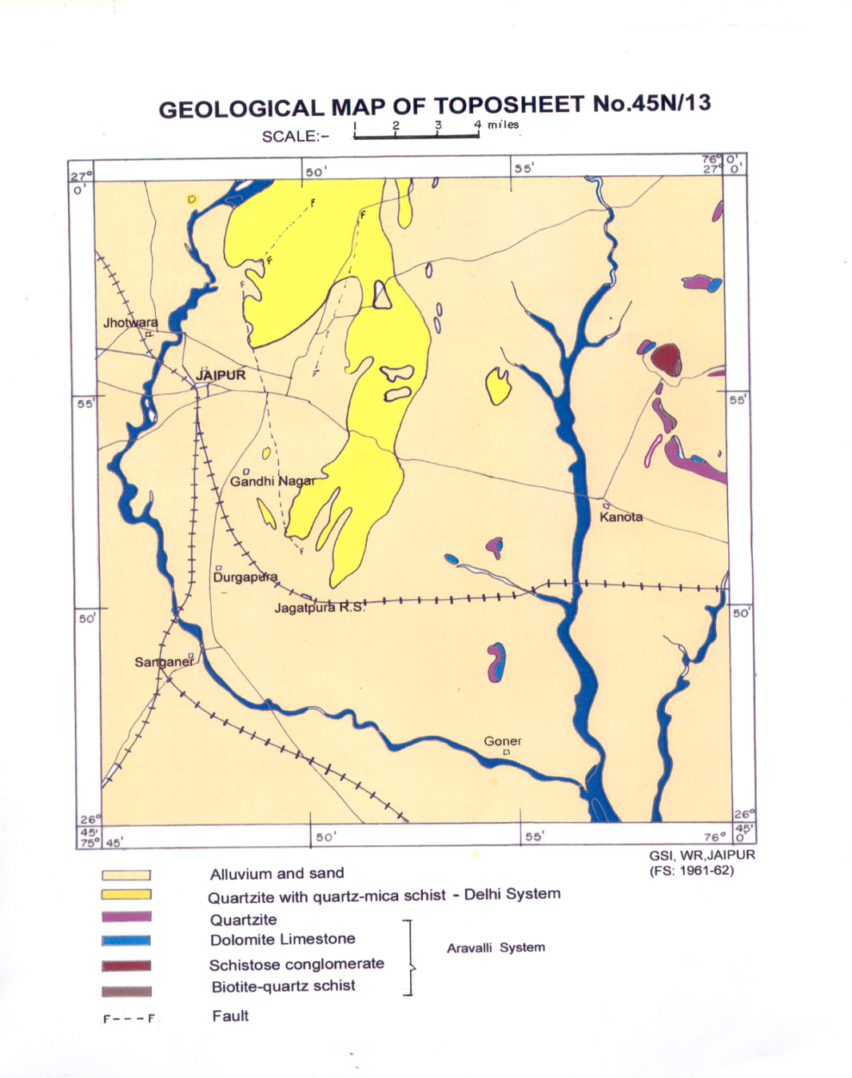
Jaipur was founded on 18 November 1727 by Jai Singh II, the ruler of Amer, and after whom the city is named. During the rule of Sawai Ram Singh I, the city was painted pink to welcome the Prince of Wales, later Edward VII, in 1876

Slide 22
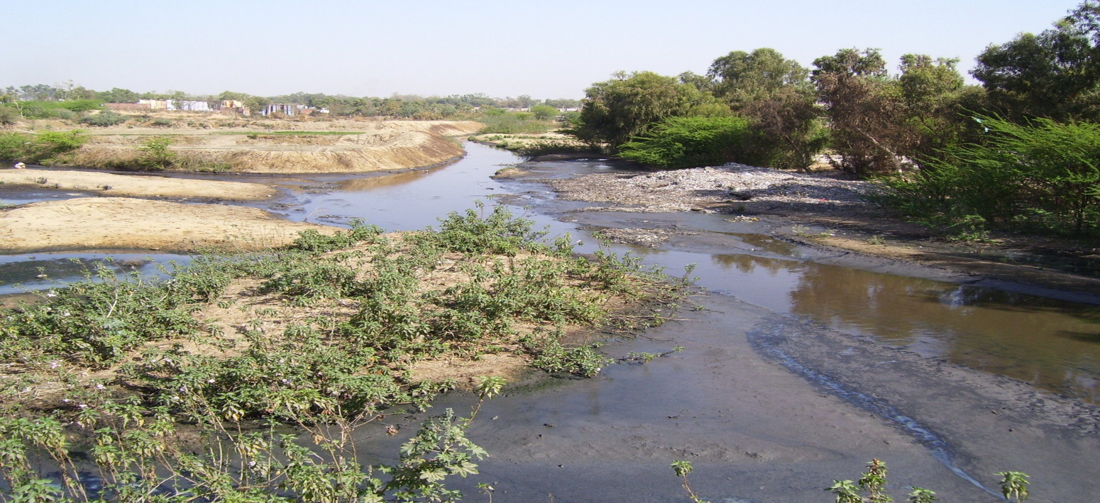
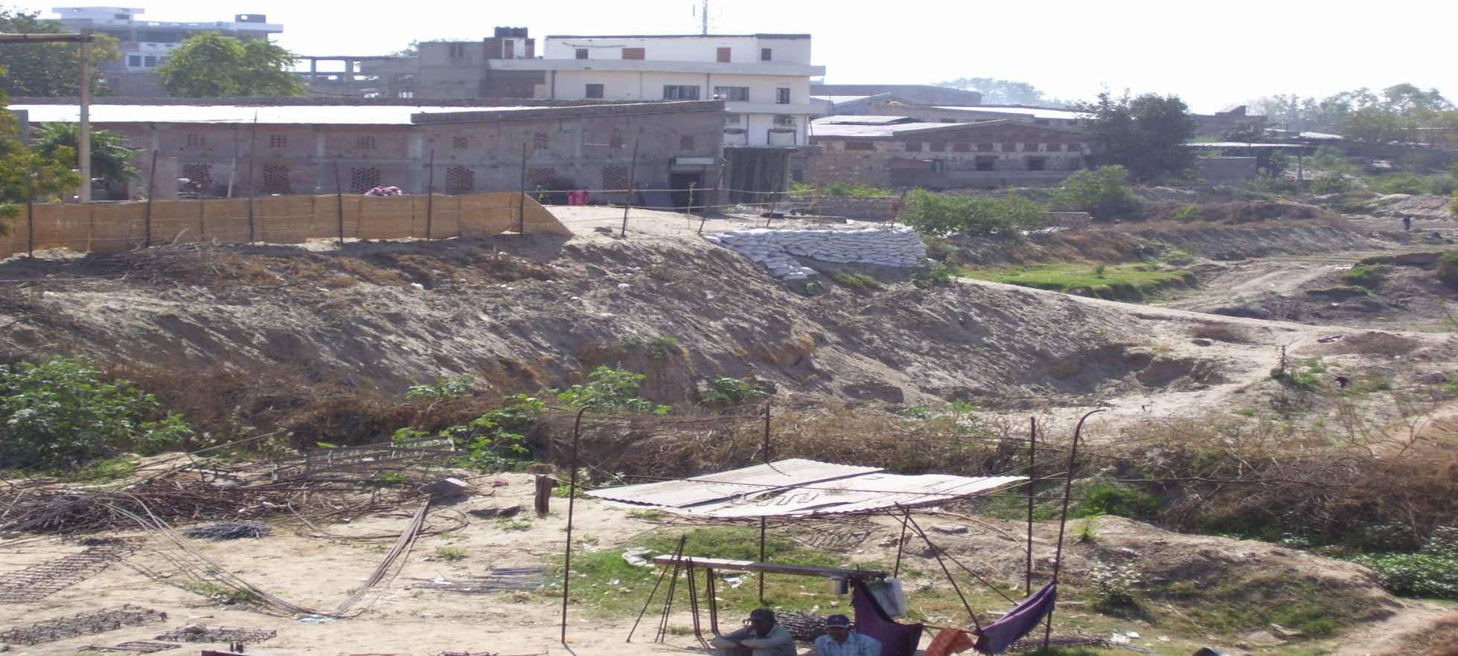
AMANISHAH NALA in 2008
ENCROACHMENTS, waste dumping

Slide 23
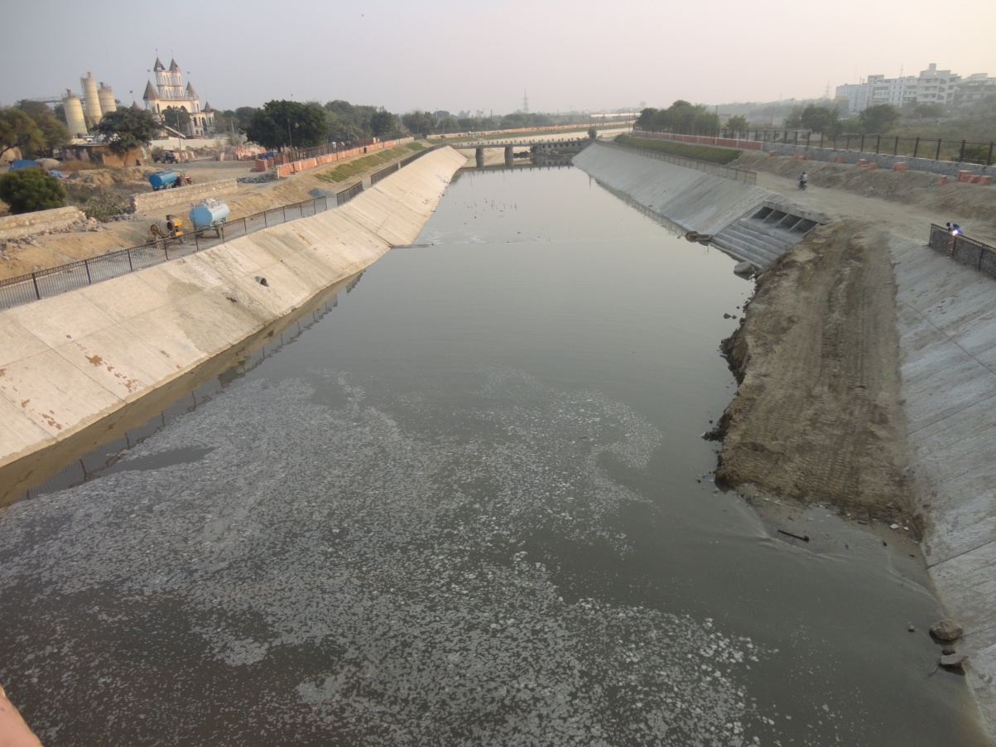
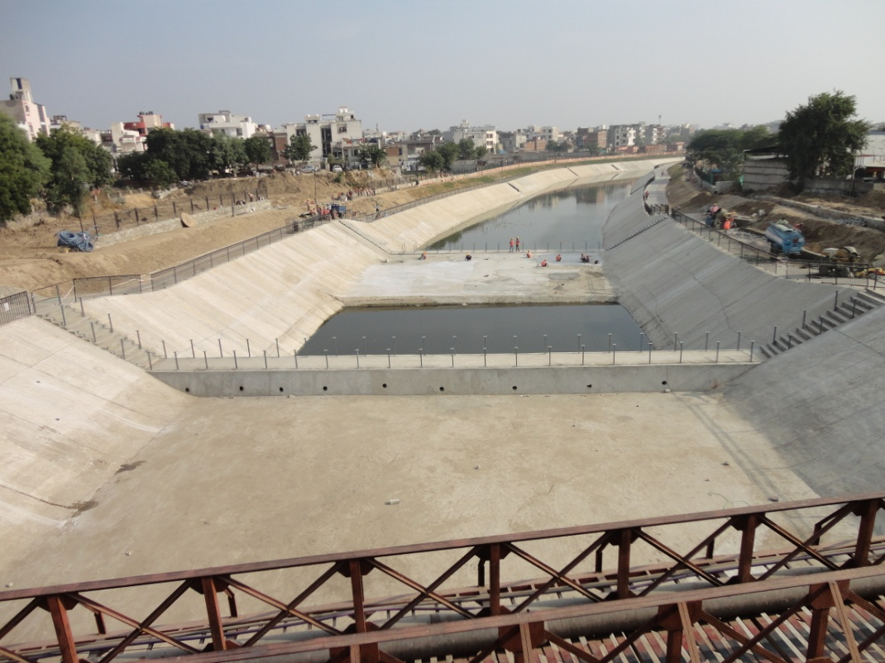
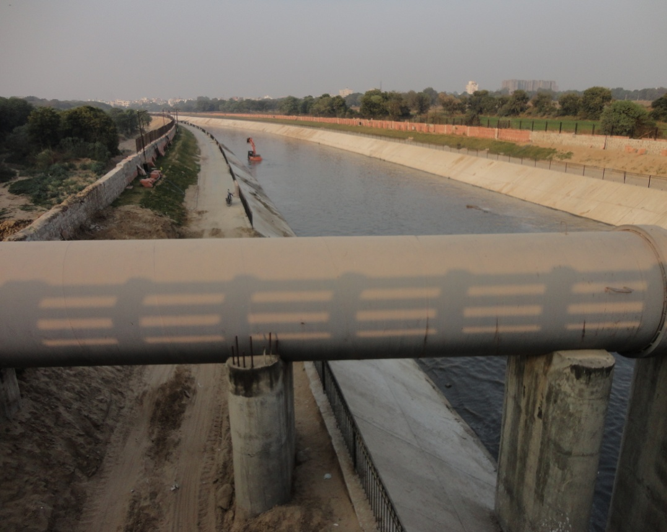
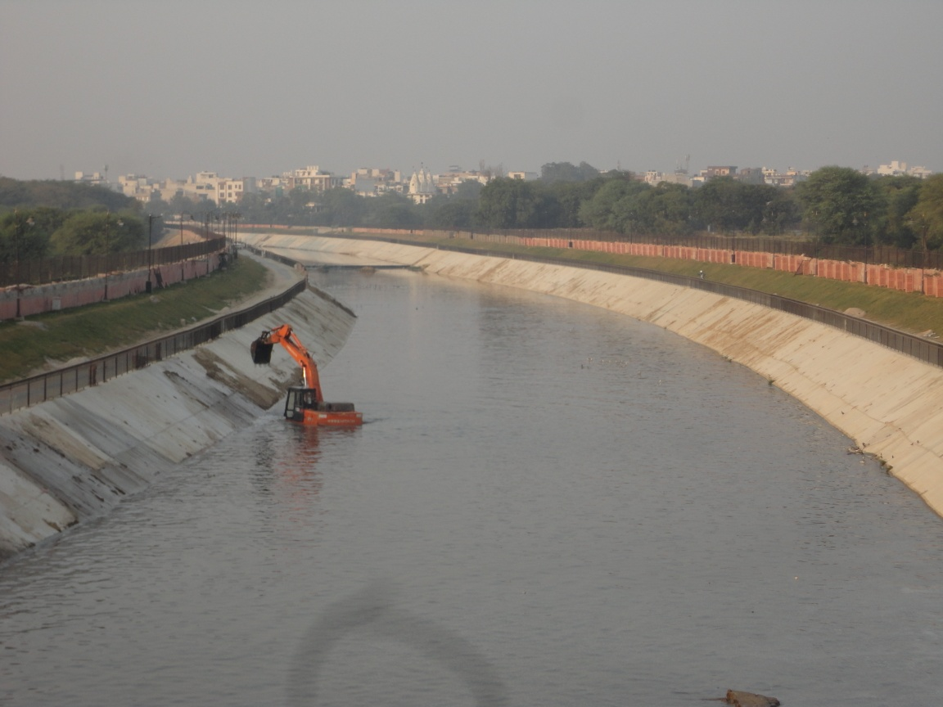
RESTORATION OF NALA AS DRVAYAVATI NADI 2018

Slide 24
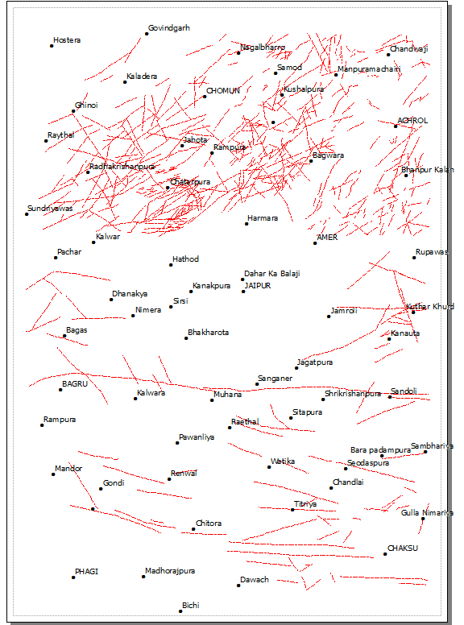
Major tectonic Lineaments ideally suited for groundwater recharge zones
Well drained Sandy soils suited
For agricultural practices,
cash crops
Recycling liquid waste for
natural slow percolation
and conservation
Septic-tank sewage disposal here may produce public health problems

Slide 25
GEOLOGICALLY FAVAOURABLE LOCALES FOR WATER HARVESTING vs. RECHARGE STRUCTURES
ZONES
1. FOOT HILL ZONE
2. BUILT-UP AREAS
3. LINEAMENT ZONE
4. EPHEMERAL DRAINAGES
EPHEMERAL
PONDS
6. INDUSTRIAL & SEWAGE TREATMENT PLANT AREAS
RECHARGE STRUCTURES
DITCHES, PERCOLATION TANKS ETC.
ROOF TOP HARVESTING
INVERT WELLS;PERCOLATION
TANKS IN HARD ROCKS AREA.
SUB SURFACE DYKES;
DITCH & FURROW METHOD
PIT & SHAFT METHOD
WASTE WATER RECLAMATION

Slide 26
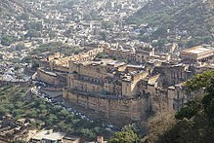
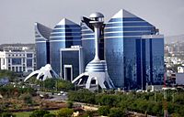
Smart city: Jaipur blending modernity with heritage
Amer Fort as seen from the Jaigarh Fort
WORLD TRADE PARK

Slide 27
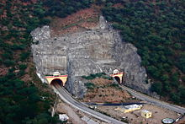
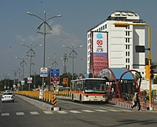
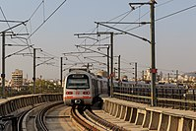
Ghat ki Guni Tunnel on National Highway 11 [Bikaner- Jaipur to Agra]
Jaipur Bus Rapid Transit System- BRTS since August 2006
JAIPUR METRO commissioned since 3rd June 2015

Slide 28
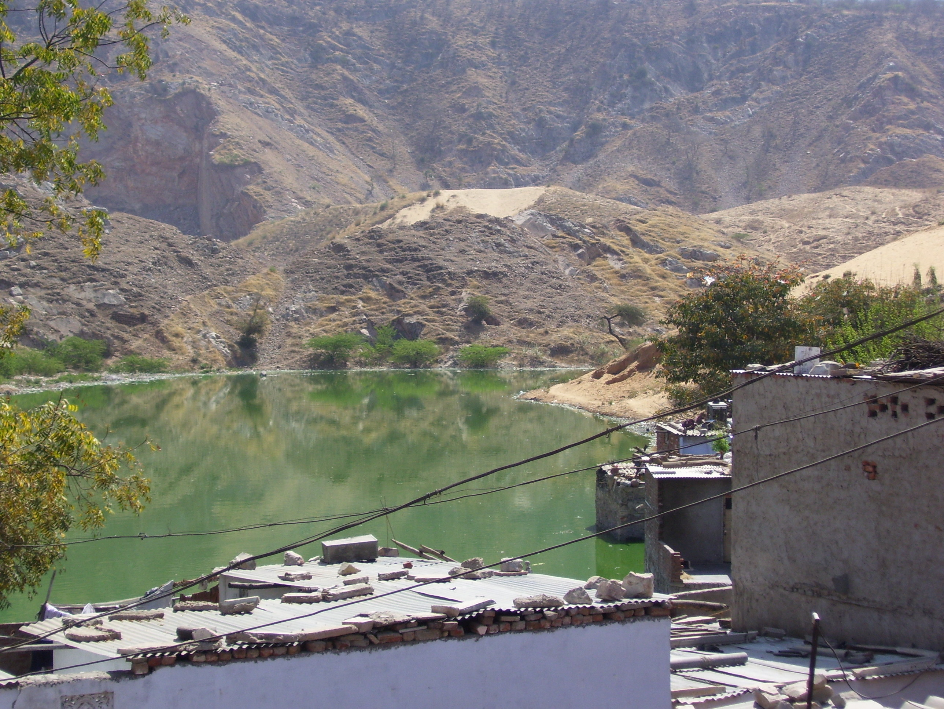

Slide 29
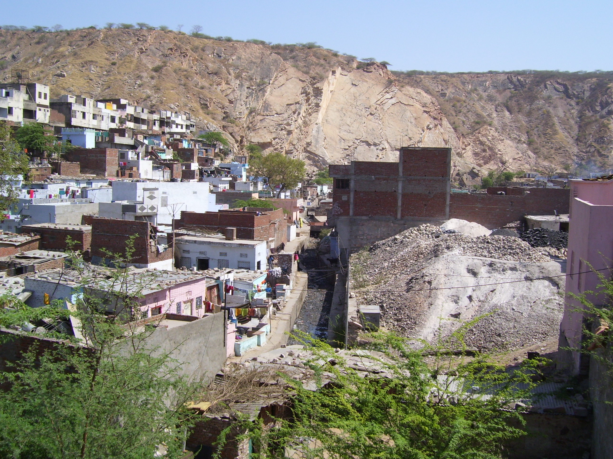
URBAN ENCROACHMENTS OBSTRUCTING NATURAL DRAINAGE FLOW

Slide 30
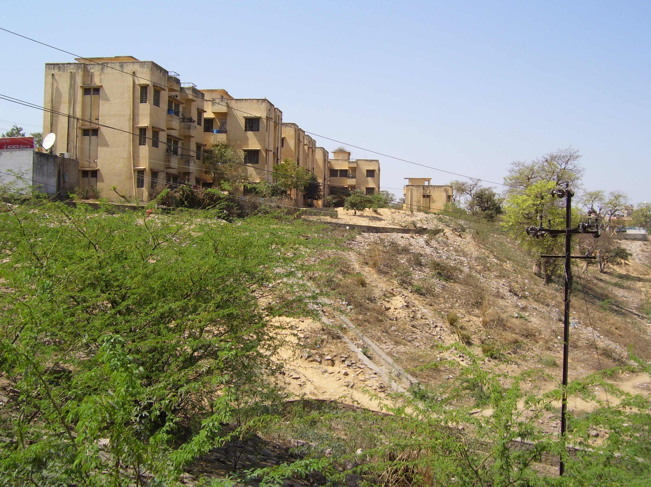
Poorly consolidated sandy deposits are vulnerable to erosion by running water and will pose problems for foundation failure
Lined gullies/ drainage

Slide 31
Notes:
31

Slide 32
Zones Vulnerable to Groundwater Quality Deterioration
Abnormal incidence of: (permissible limit)
Nitrate (=100mg/l)
Fluoride (=1.5mg/l)
TDS / EC (=3000 m mhos at 25 C)
Iron (=1.0mg/l)
Fluoride/ iron/ nitrate/ TDS (more
Notes:
32

Slide 33
Notes:
33

Slide 34
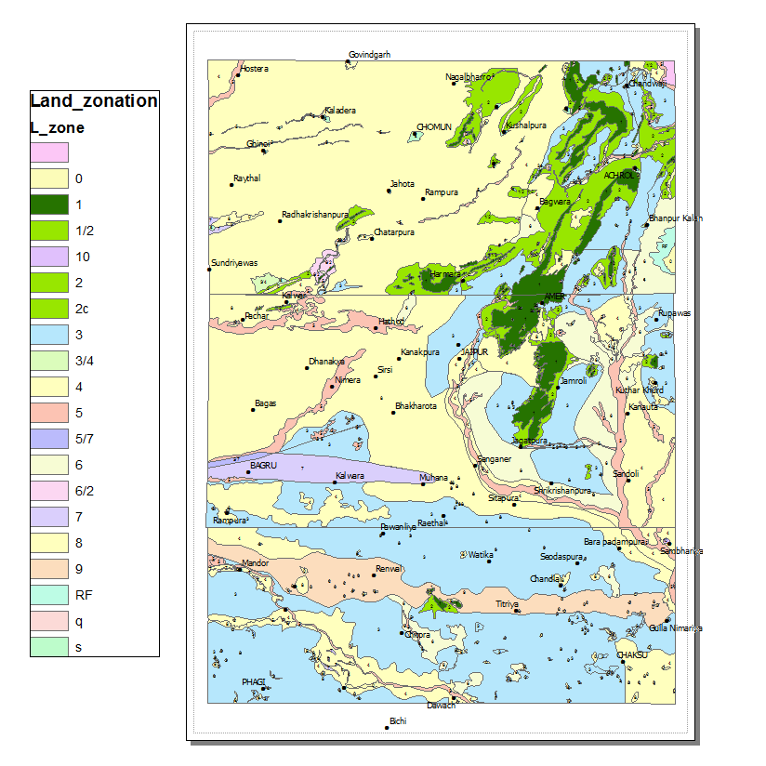
Geofactors based Land capability Zonation

Slide 35
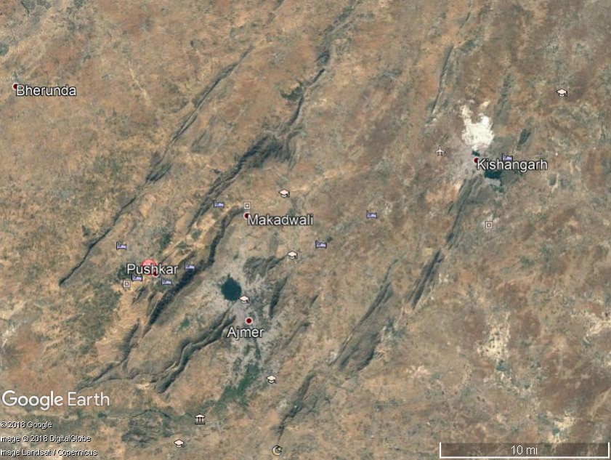
AJMER – PUSHKAR REGION

Slide 36
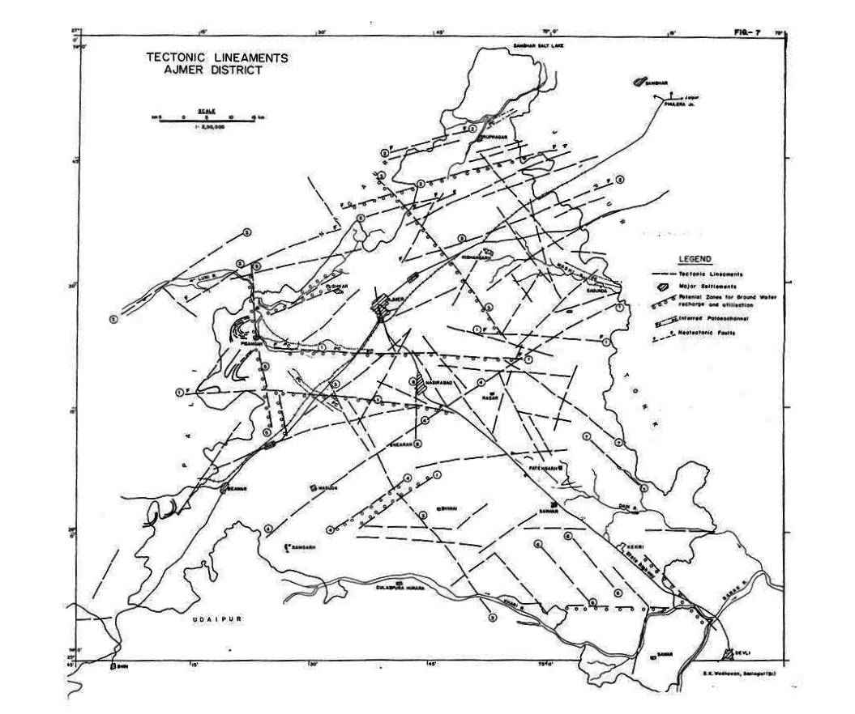
F
F
F
F

Slide 37
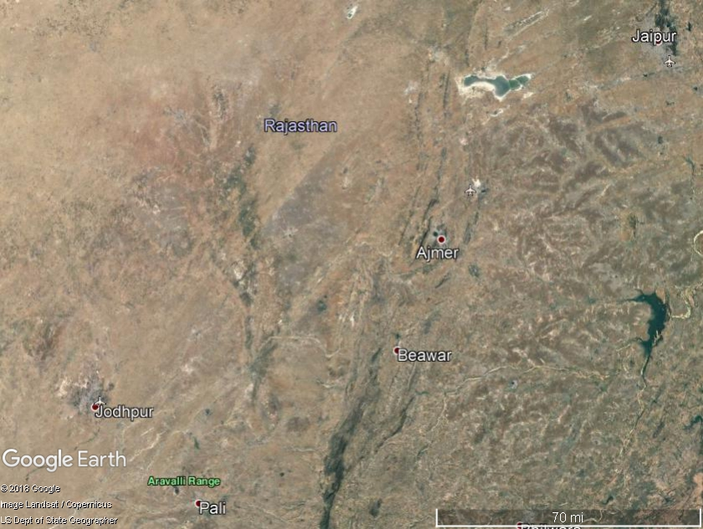
THAR DESERT
DRYLAND ENVIRONMENT

Slide 38
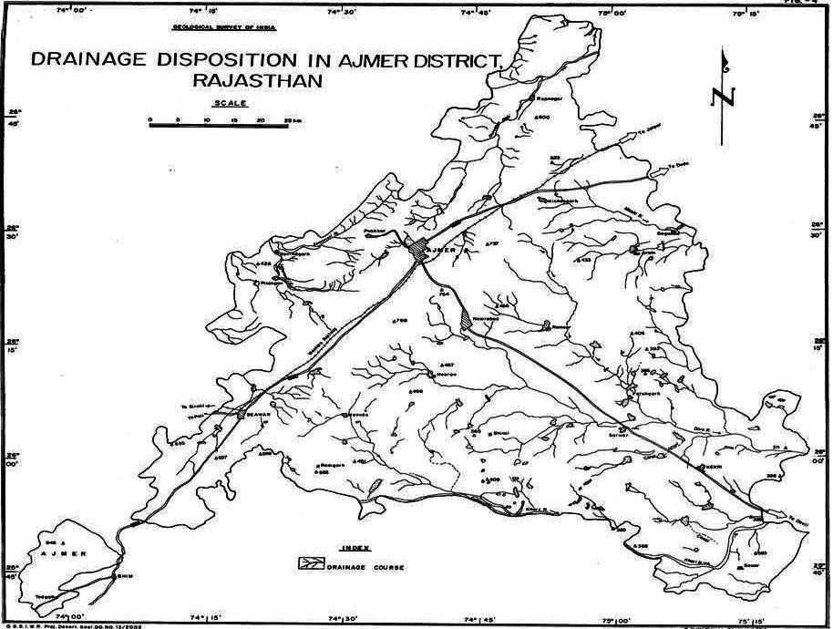
Rejuvenate water bodies and rivers

Slide 39
Urban waste management – disposal / recycle
Dilute and Disperse – Old Concept
Concentrate and Contain – vulnerable to Leakage and Escape
Segregate and Recycle [Waste To Resource]
Waste Water Treatment – waste water renovation and conservation recharge + sludge
Innovative Cost Effective Strategies Needed

Slide 40
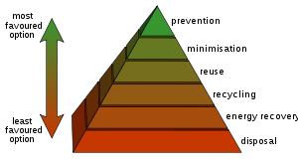
Diagram of the waste hierarchy:
"3 Rs" REDUCE, REUSE AND RECYCLE

Slide 41
Electrical waste ..
Electrical waste contains hazardous, but also valuable and scarce materials.
Up to 60 elements can be found in complex electronics
In the United States, an estimated 70% of heavy metals in landfills come from discarded electronics.
According to a study, India produces nearly 18.5 Lakhs MT of electronic waste every year

Slide 42
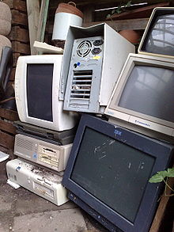
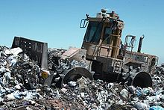
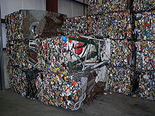
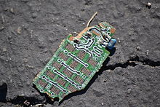
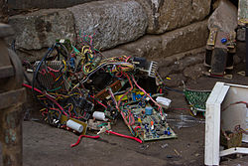
CRUSHED AND COMPACTED WASTE METAL SCRAP and Electronic scrap components = E-waste FOR RECYLCING
Globally, waste-to-energy accounts for 16% of waste management GROWING E-WASTE PROBLEM
Cost effective segregation of organic and inorganic waste
Recycling raw materials from end-of-life electronics is the most effective solution to e-waste management.

Slide 43
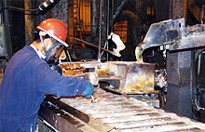
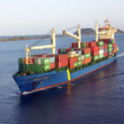
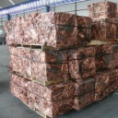
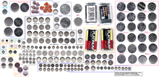
Recycling the lead from batteries
Cells contain Lithium, lead, mercury and cadmium

Slide 44
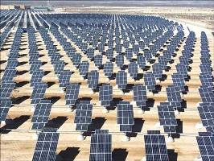
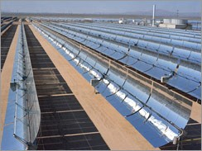
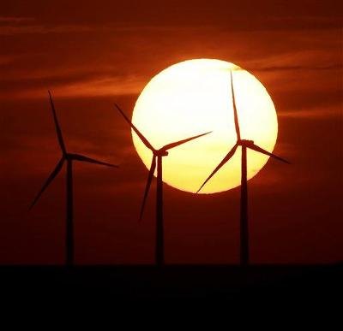
New and Renewable Energy
Solar Power Panels

Slide 45
CONCLUSIONS - 1
Smart city cannot not be treated in isolation; entire hinterland region needs to be considered for holistic and comprehensive geoenvironmental evaluation of resources and hazards….., Inclusive growth
Plan for Decongestion and Decentralised Urban Growth Centres [SATELLITE TOWNS] to be sustainable with improved fast connectivity and creation of civic amenities
Water Resource: a] Rain Water Harvesting be made mandatory.
b] RESTORE AND REVIVE WATER BODIES/ reservoir capacity/ watersheds. Plan for importing water through inter-basin transfer of surface water/ LINKING OF RIVERS

Slide 46
CONCLUSIONS -2
4. Sustainable solid waste management should consider WASTE-TO-ENERGY & RESOURCE RECOVERY through segregation & metallurgy
5. RECOVER STRATEGIC / ENERGY CRITICAL METALS FROM E-WASTE. Precious metals can be recycled to create a profit,
6. Encourage CONSERVATION and SUBSTITUTION
7. Attach due importance to Geofactor considerations [urban geology] as land use determinants while making waste disposal for sustainable management and resource [water, energy and minerals/rocks] utilisation

Slide 47

THANK YOU

Slide 49
FUNDAMENTAL CONCEPTS OF ENVIRONMENTAL GEOLOGY
FC-5: Land and water use planning must strive to obtain a balance between economic considerations and the less tangible variables such as landscape aesthetics
FC-6: Effects of land use tend to be cumulative and therefore we have an obligation to those who follow – the next generation.
RESOURCUNG FOR FUTURE GENERATIONS [RFG]
Concept of sustainable development - recognition of temporal relationship wherein the ethical considerations suggest that man should utilize resource to meet not only today’s needs, but also the needs of future generations...

Slide 50
TECHNOLOGY METALS
Molybdenum (Mo),
Rhenium (Re),
Tellurium (Te),
Selenium (Se),
Germanium (Ge),
Cadmium (Cd),
Indium (In),
Gallium (Ga),
Vanadium(V) and
Scandium (Sc)
Lithium (Li)
ENERGY CRITICAL ELEMENTS:
Gallium (Ga)
Germanium (Ge),
Selenium (Se)
Indium (In),
Tellurium (Te),

Slide 51
HIGH TECHNOLOGY METALS
CRITICAL MATERIALS are considered to be of high economic or trade importance
Needed for green energy programmes wind mills, solar power generation / storage devices
STRATEGIC MATERIALS are essential to a country’s defence and strategic applications
Bi, Sb, Ga, In, Mo, Rh, Se, Ni, Co, W, Ni, Ta, REE
the supply chain vulnerability/disruptions of these metals needs careful evaluation, to safeguard domestic interests

Slide 52
Technology Metals -1
Minor metals produced as by-products of base metals (Mo, Re, Te, Se, Ge, Cd, In, Ga, V, Sc)
Molybdenum, Rhenium (nearly 75% of world’s production),
Tellurium and Selenium (95% of world’s production) come from copper mines and they are by-products of copper concentrators and smelting plants.

Slide 53
Technology Metals - 2
Ge, Cd and In which come from the Zn primary circuit.
Ga: Bayer Liquor in Aluminium extraction process is the only source for Gallium metal which together with arsenic (Gallium arsenide) is an important semiconductor
Vanadium occurs both as primary and as secondary source. It is found in significant quantities in Bayer liquor in aluminium processing [Red mud waste]
Strategy: a multi metal extraction process technology would have made India the largest producer of Ga and V as well..

Slide 54
Technology Metals - 3
Scandium generally occurs along with Tin- an urgent need to study the Sn minerals and Sn slag for occurrence of Scandium.
Chrome-ore which is mined in Orissa as the source for ferro-chrome for making standard steel and other corrosion resistant high strengths steels.
Nickel that co-occurs with chromium ore burden has not been exploited
Kolar Gold Field waste dumps contain Tungsten
Lithium - used in Solar energy conversion devices

Slide 55
Recycle Electrical Waste
India's electronic waste is likely to reach 30 lakh metric tonnes (MT) per year by 2018 from the present level of 18.5 lakh metric tonnes (MT) with Mumbai being the largest contributor to the problem.
The sad part is that mere 2.5% of India's total
e-waste gets recycled because of poor infrastructure and legislative framework managed by the unorganised sector and scrap dealers in this market.

Slide 56
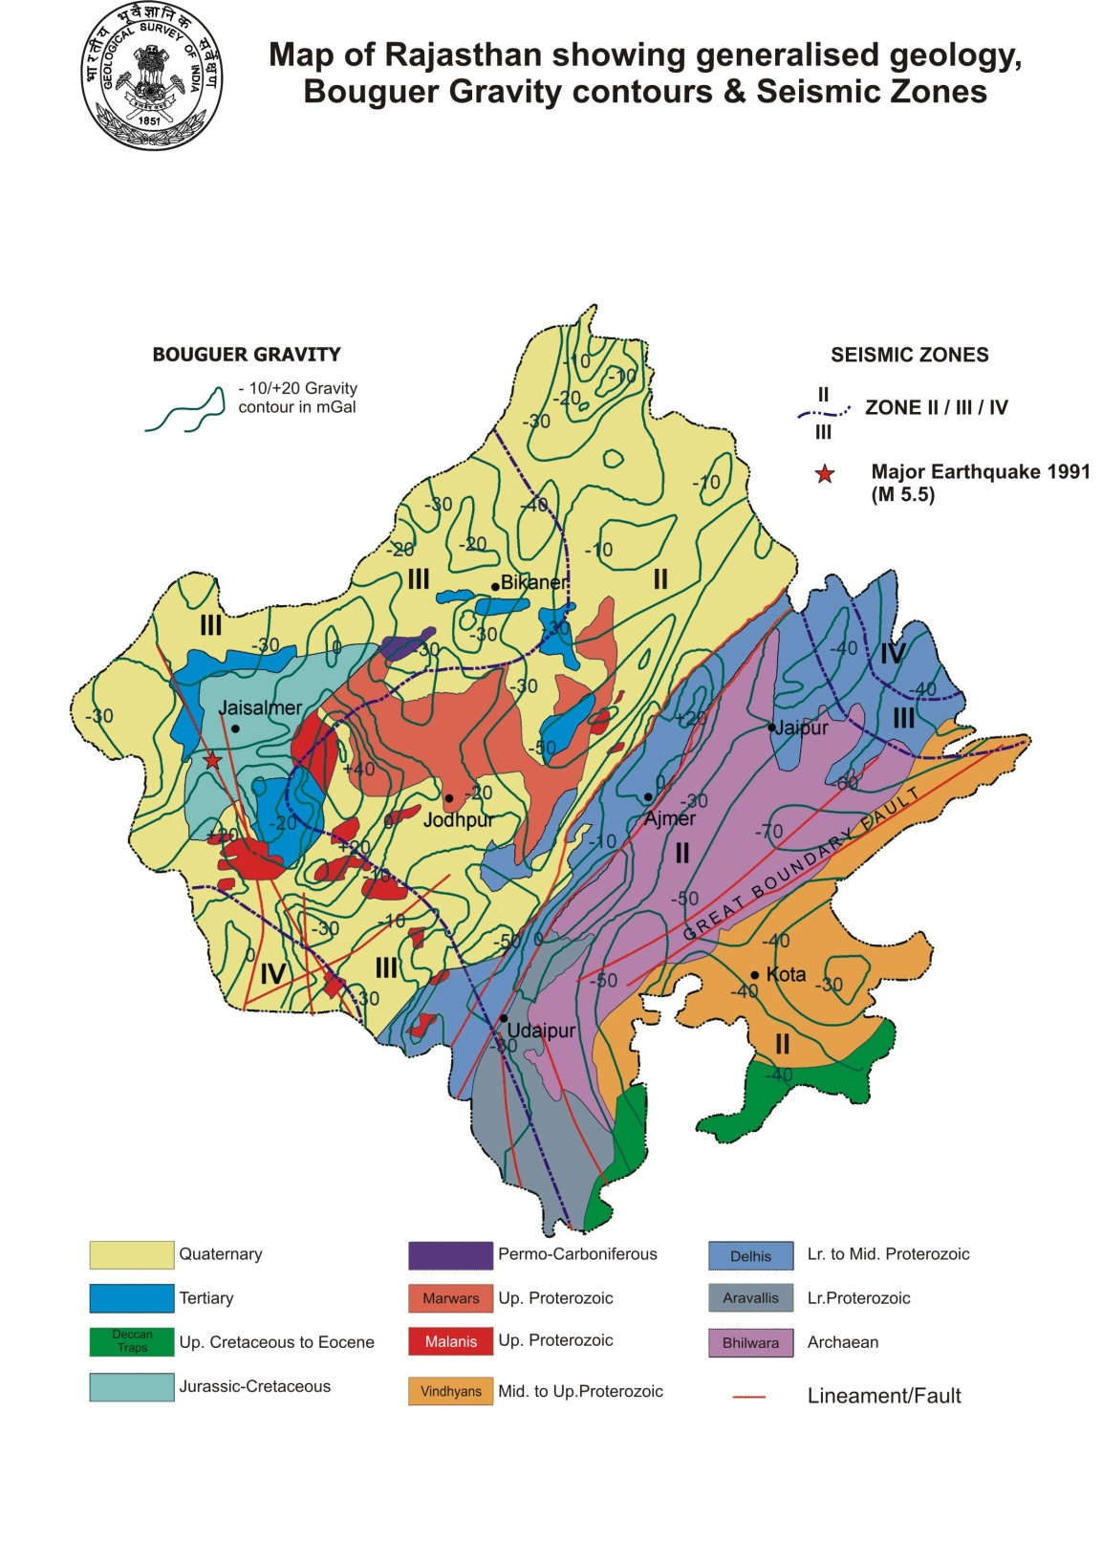

Slide 57
Geofactor based Land capability Zonation-1
Ecosensitive zones:
Priority to afforestation, regeneration of RF, PF; Ecological reserves, wild life sanctuaries; Environmental safe and sustainable mining sites for building material, bajri, silty clay (bricks)
2) Piedmont Zone suitable for agro-forestry, groundwater recharge structures, ecotourism
3) Land unit suitable for residential, urbano-industrial and trade & commercial activities

Slide 58
Geofactors based Land capability Zonation-2
4) Exclusive Agricultural Zone
(Bandi River basin and fluvio-aeolian deposits)
Food security, suitable soils and groundwater conditions, safety from industrial pollution, higher recharge potential (fracture system)
5) Zone of flood plains: accord priority to ecological reserves, recreation resorts,
remove obstructions from active channel bed (Amanisha nala). River front development for recreation and safe green belts

Slide 59
Geofactor based Land capability Zonation- 3
6) Sites suitable for urban solid waste disposal and management in Jaipur region : inert and impervious substrata, degraded/ gullied sites, abandoned quarry pits, etc.
7) Sites suitable for renewable energy resources (solar and winds); well designed green buildings, technology and energy efficient, conserve and recycle

Slide 60
Desertification
Destabilization of obstacle dunes / Sand sheet cover
Active / semistable (Barchans) dunes
Deterioration / intensified use of fragile ecosystem / incompatible landuse

Slide 61
Zones Vulnerable to Groundwater Conditions
Overexploited (Highly depleted / critical) zones
Degraded aquifer conditions / rock types/ Quaternary deposits

Slide 62
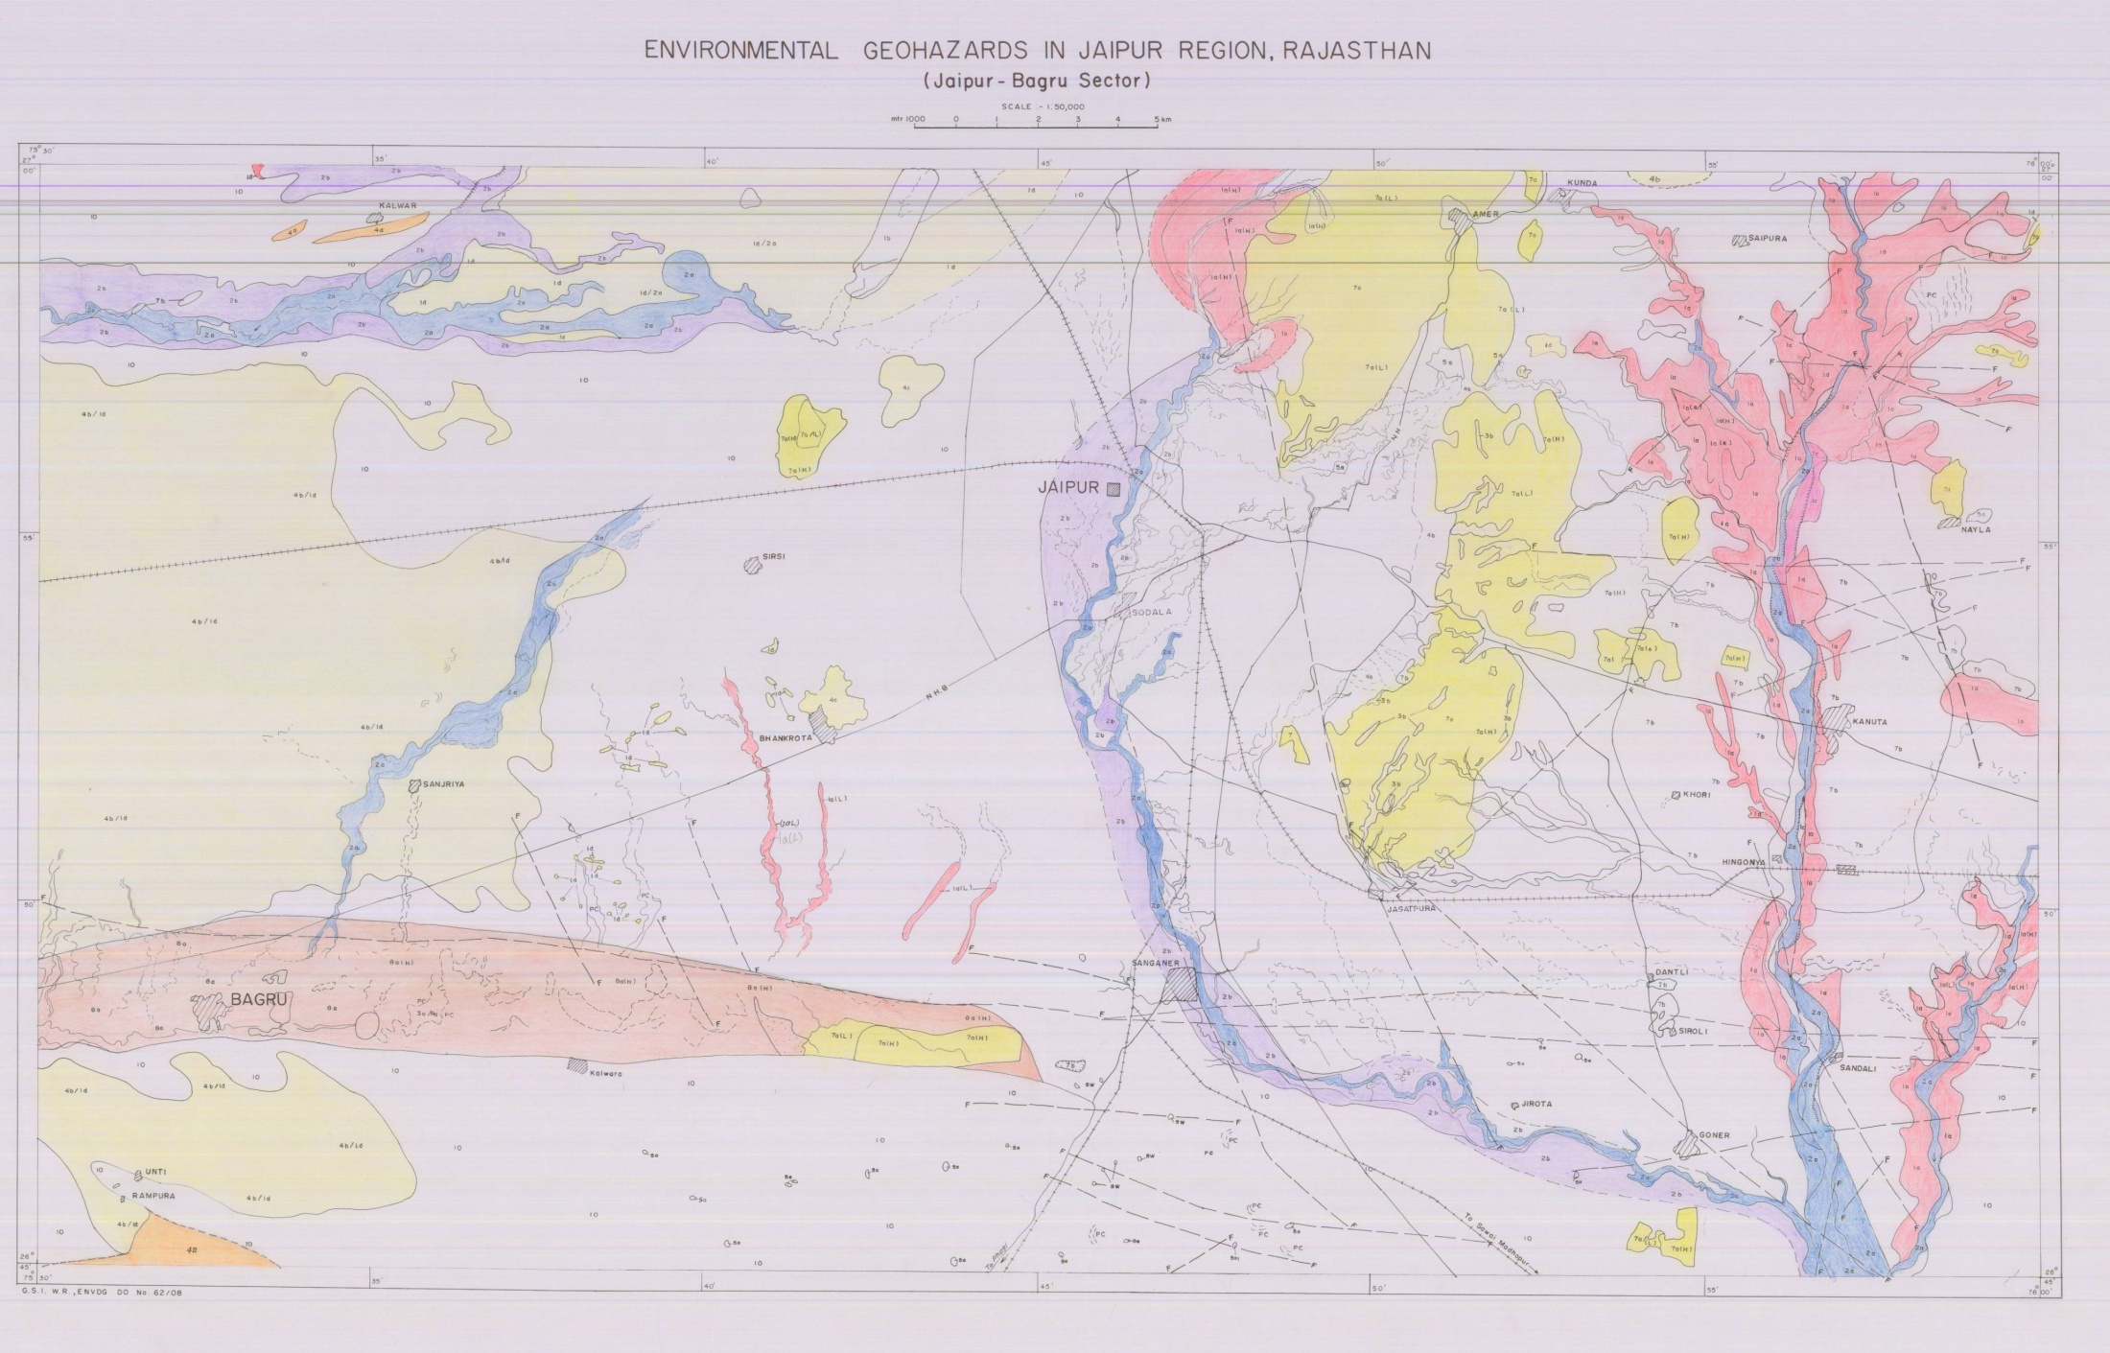

Slide 63
Geofactor based Land capability Zonation-1
Ecosensitive zones:
Priority to afforestation, regeneration of RF, PF; Ecological reserves, wild life sanctuaries; Environmental safe and sustainable mining sites for building material, bajri, silty clay (bricks)
2) Piedmont Zone suitable for agro-forestry, groundwater recharge structures, ecotourism
3) Land unit suitable for residential, urbano-industrial and trade & commercial activities

Slide 64
Geofactors based Land capability Zonation-2
4) Exclusive Agricultural Zone
(Bandi River basin and fluvio-aeolian deposits)
Food security, suitable soils and groundwater conditions, safety from industrial pollution, higher recharge potential (fracture system)
5) Zone of flood plains: accord priority to ecological reserves, recreation resorts,
remove obstructions from active channel bed (Amanisha nala). River front development for recreation and safe green belts

Slide 65
Geofactor based Land capability Zonation- 3
6) Sites suitable for urban solid waste disposal and management in Jaipur region : inert and impervious substrata, degraded/ gullied sites, abandoned quarry pits, etc.
7) Sites suitable for renewable energy resources (solar and winds); well designed green buildings, technology and energy efficient, conserve and recycle

